Slide 1
Research Analytics – Environment Setup
Kirky DeLong & Glenda Stump

Slide 2
Agenda
By the end of this session, you will have …
  installed and configured the software necessary to run the research scripts,
  created a Python sandbox environment for running the research scripts developed by Cole and Glenda,
  run the Student activity / timestamp CSV with interactives script from your local computer, and
  reviewed the CSV files that the research scripts produce.

Slide 3
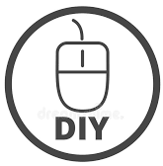
Copy folder from USB Drive
Please copy the “MIT-CLIx-Session” folder from the USB drive to your computer’s desktop.

Slide 4
What is on the USB Drive?
SOFTWARE | SCRIPTS | DATA SETS
Python – version 2.7 MongoDB – version 3.4 Wget – version 1.11 | Student activity / timestamp CSV with interactives Assessment / click-log CSV OST / RKR click-log CSV | rj16 mz10 mz22 mz25
Notes:
In order to analyze the data being gathered in the field, you will need to install and use several pieces of software.
Wget – this is used to copy the data from the server to your local hard drive.
MongoDB – this is the database where the CLIx data is stored.
Python – this is the programming language used to develop the scripts.
Scripts – these are Python scripts that go through the data in the MongoDB and collect selected pieces of information.
Windows Terminal – sometime called the “command prompt”, the Windows Terminal is where you will type in the script commands.

Slide 5
DOS and the Command Prompt
cmd – command prompt or terminal
cd – change directory
directory = folder
usage: cd <<directory_name>>
dir – directory listing

Slide 6
Install Python programming language
In the Windows Explorer
Open the “MIT-CLIx-Session” folder
Double-click on
  python-2.7.15.amd64.msi to launch the installer

Slide 7
Install Mongo database
In the Windows Explorer
Open the “MIT-CLIx-Session” folder
Double-click on
  mongodb-win32-x86_64-2008plus-ssl-3.4.16-signed.msi to launch the installer

Slide 8
Install Wget application
In the Windows Explorer
Open the “MIT-CLIx-Session” folder
Double-click on
  wget-1.11.4-1-setup.exe to launch the installer

Slide 9
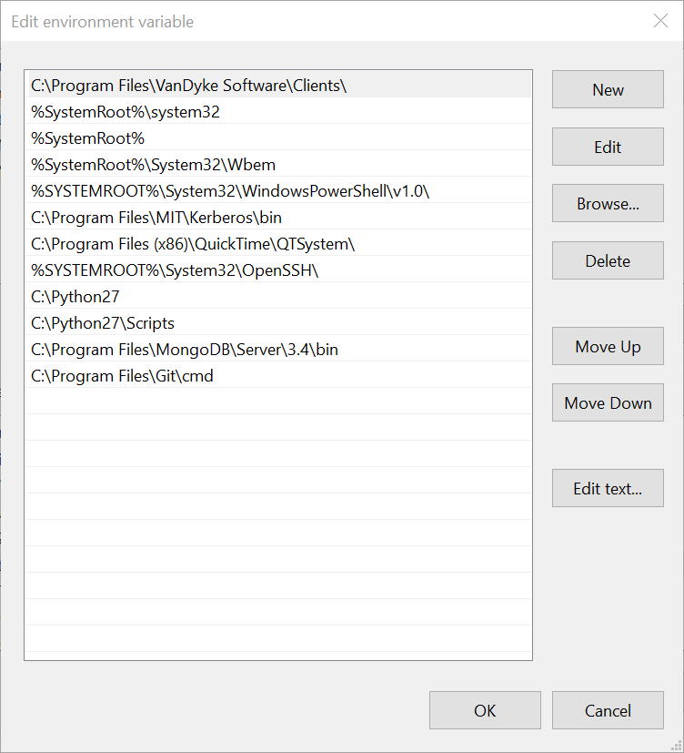
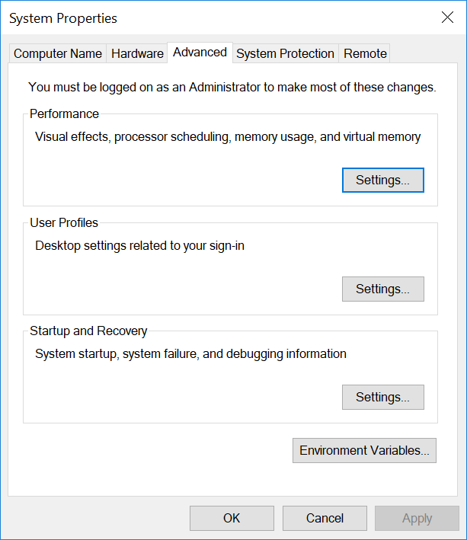
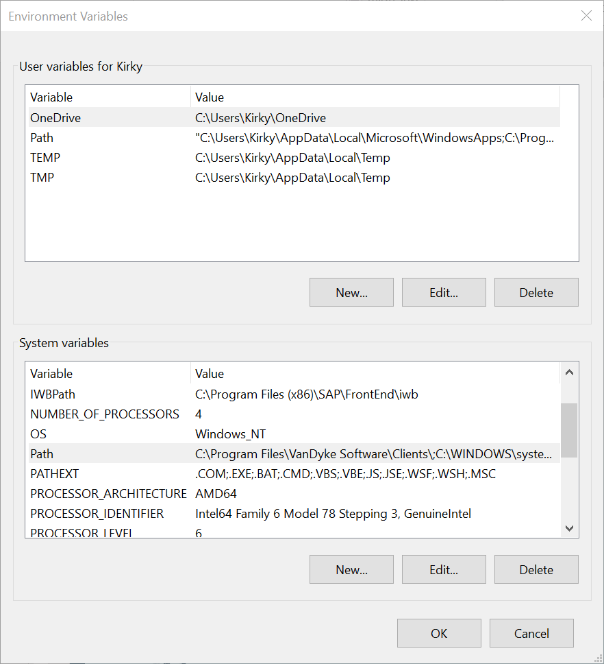
Update the Windows PATH variable
Search for "advanced settings" in the search bar
Click "Environment variables"
Under "System variable" look for "Path"
Highlight the "Path" variable and select Edit
Add new entries
4
1
2
C:\Python27
C:\Python27\Scripts
C:\Program Files\MongoDB\Server\3.4\bin
3

Slide 10
C:\Python27
C:\Python27\Scripts
C:\Program Files\MongoDB\Server\3.4\bin

Slide 11
1

Slide 12
2
3

Slide 13
4

Slide 14
4
1
2
3

Slide 15
Create a Mongo data directory
In the Windows Explorer
Navigate to the C root drive
Create a new folder called “data”
Open the new “data” folder
Create a subdirectory called “db”

Slide 16
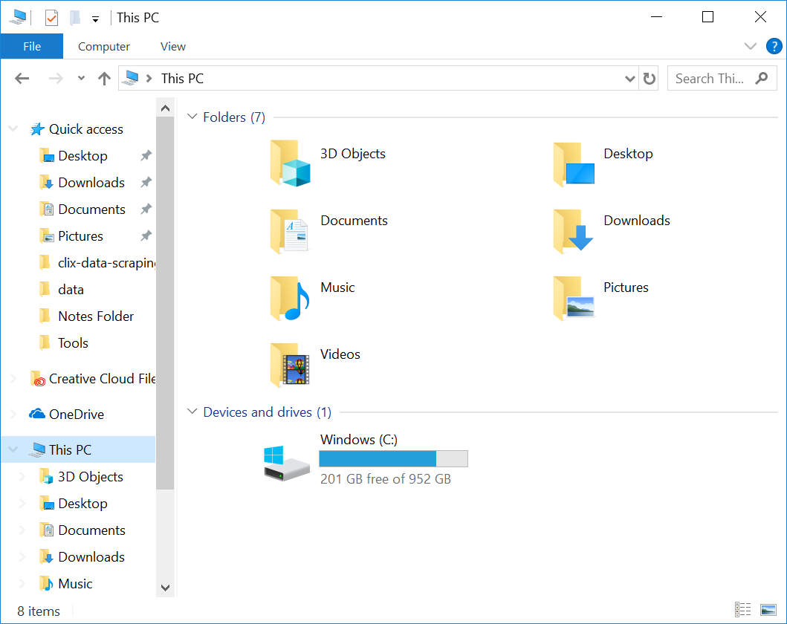

Slide 17
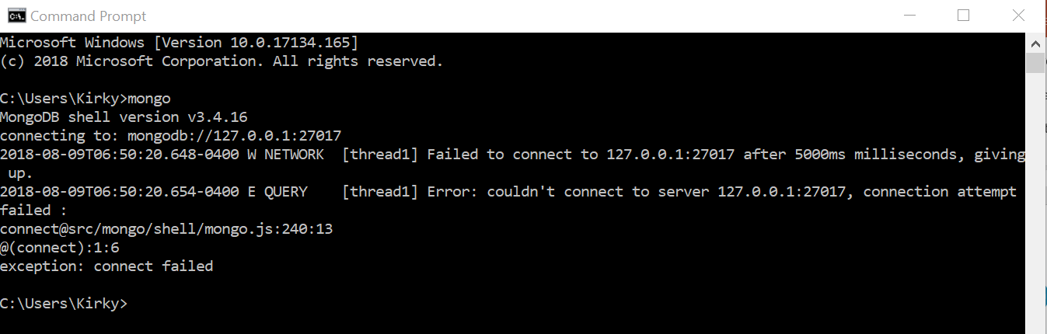
Test your MongoDB installation
Open a Terminal / Command Prompt
  Type CMD into the search bar
In the terminal, type: mongo
Message: “connect failed”

Slide 18
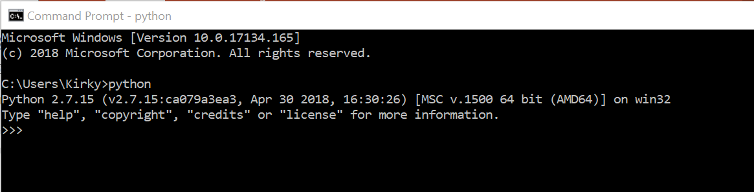
Test your Python installation
In the Terminal
Type: python
Message: “>>>”
Type: exit()

Slide 19
What is a Sandbox Virtual Environment?
A Virtual Environment is an isolated working copy of Python which allows you to work on a specific project without worry of affecting other programs.
Safe environment
Configurable
Reusable

Slide 20
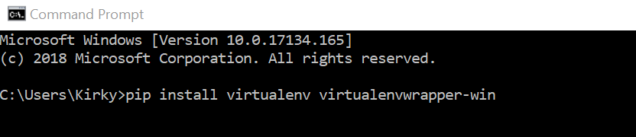
Install sandbox environment software
This step requires the Internet.
Open a new Terminal
Type:
pip install virtualenv virtualenvwrapper-win

Slide 21
Create a sandbox and name it
Open a new Terminal
Type: mkvirtualenv clix-data
This can be any name you want

Slide 22
Install libraries needed for scripts
This step requires the Internet.
In the Terminal
Navigate to the scripts directory
Type: pip install -r requirements.txt

Slide 23
Setup scripts environment
In the Windows Explorer
Open the “MIT-CLIx-Session” folder
Create a copy of the settings.py.example file.
Name this new file settings.py

Slide 24
Setup scripts environment (2)
Open the IDLE (Python GUI) editor using the search bar
In the editor Select File -> Open
Navigate to the “MIT-CLIx-Session” folder
Open the settings.py file
Edit and Save

Slide 25
Editing the settings.py file
# Use a non-standard MongoDB port
MONGO_DB_PORT = 27027
MONGO_DB_HOST = '127.0.0.1'
SYNC_DATA_PATH = 'data‘
JENKINS_JOB_BUILD_PATH = ('/home/.jenkins/jobs/your-sync-job/' 'builds/lastSuccessfulBuild/build.xml')

Slide 26
Sandbox environment complete
Please close any open Terminals.

Slide 27
Scripts
Student activity / timestamp CSV with interactives
Assessment / click-log CSV
OST / RKR click-log CSV

Slide 28
Anatomy of running a Python script
Open a terminal using the CMD command
Navigate to the directory with the scripts
Open the Sandbox environment
Type: workon clix-data (or whatever you named your sandbox)
(clix-data) $ python <<script_name>>.py
--parameter_name=<<parameter_value>>
--parameter_name=<<parameter_value>>
Script command must be in a single line – no returns.

Slide 29
Student activity / timestamp CSV Script with interactives
Script name: track_student_activity.py
arguments:
  school: the school code as a string
  date: a starting date to get data from
  email: where to send the results

Slide 30
Example:
(clix-data) $ python track_student_activity.py
--school=mz10 --date=2018-05-01 --email=kirky@mit.edu

Slide 31
Assessment / click-log CSV Script
Script name: aggregate_assessment_data.py
arguments:
  bank: the bankId, from the iframe code
  offered: the offeredId, from the iframe code
  email: where to send the results

Slide 32
Example:
(clix-data) $ python aggregate_assessment_data.py
--bank=assessment.Bank%3A58c991b791d0d90467f4679d%40ODL.MIT.EDU--offered=assessment.AssessmentOffered%3A59101a5991d0d93c65c55d41%40ODL.MIT.EDU --email=kirky@mit.edu

Slide 33
What is an iframe?
An iframe is basically a container used to load content from someplace else into the current webpage.
In this case, the iframe is loading the OEA tool into the current webpage and displaying an assessment for the student to take.

Slide 34
Where do you get the iframe code?
The iframe code can be found in two places:
the authoring server <embed code>
the GStudio or Unplatform page where the assessment is located.

Slide 35
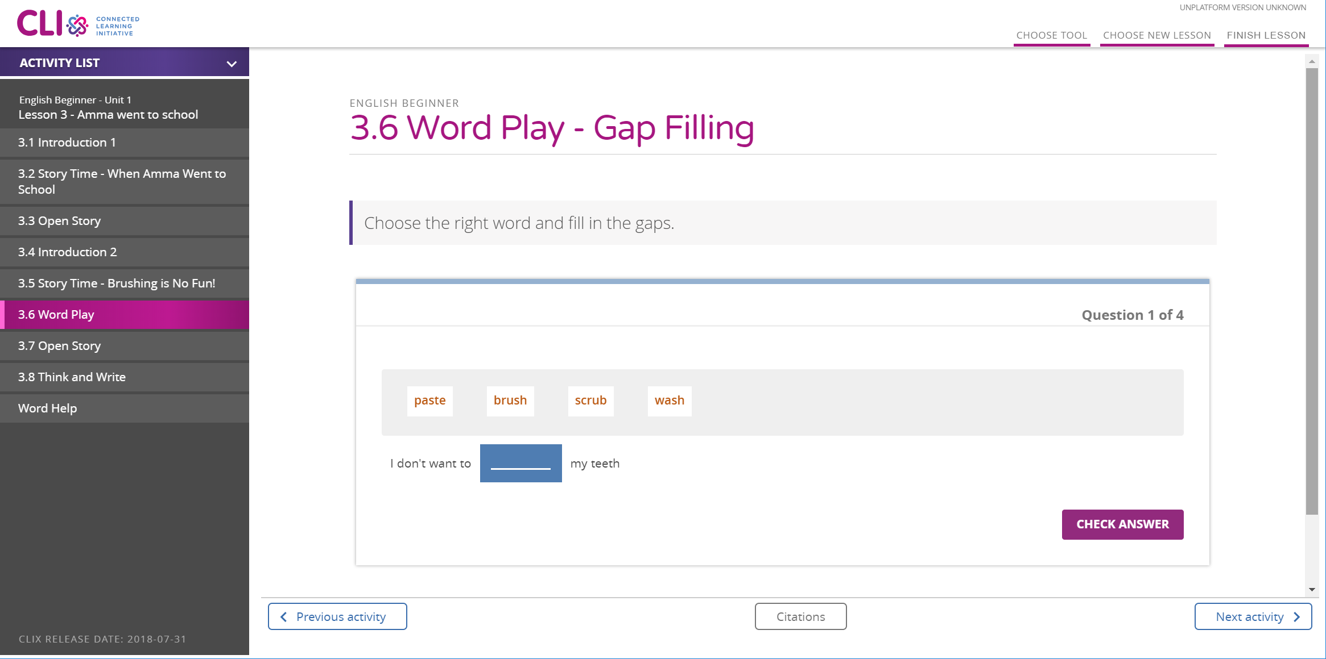
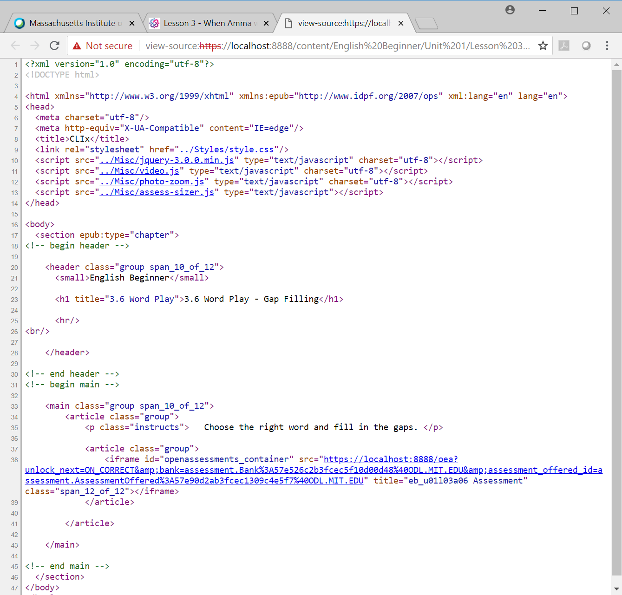
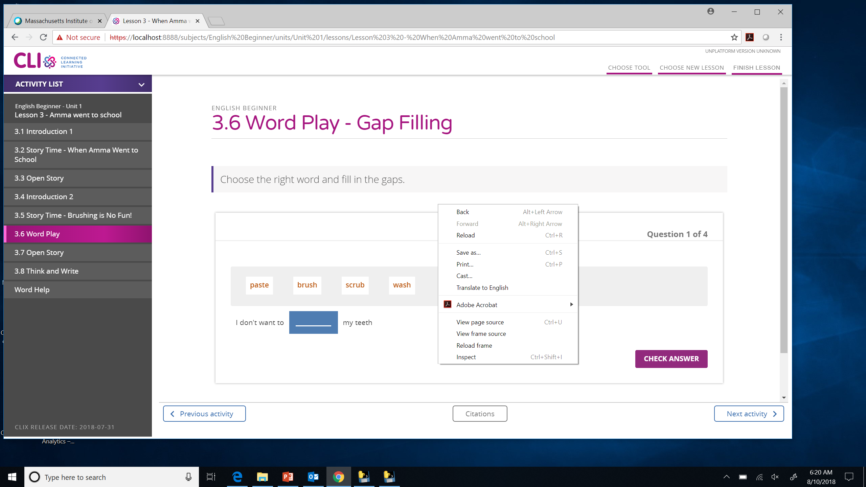
1
3
2

Slide 36
English Beginner, Unit 1, Lesson 3.
This is a word play activity.
<iframe src="https://unplatform.mit.edu/static/oea?unlock_next=ON_CORRECT&bank=assessment.Bank%3A57e526c2b3fcec5f10d00d48%40ODL.MIT.EDU&assessment_offered_id=assessment.AssessmentOffered%3A57e90d2ab3fcec1309c4e5f7%40ODL.MIT.EDU" title="eb_u01l03a06 Assessment"/>

Slide 37
Look at the iframe src variable
src="https://unplatform.mit.edu/static/oea?unlock_next=ON_CORRECT&bank=assessment.Bank%3A57e526c2b3fcec5f10d00d48%40ODL.MIT.EDU&assessment_offered_id=assessment.AssessmentOffered%3A57e90d2ab3fcec1309c4e5f7%40ODL.MIT.EDU"
https://unplatform.mit.edu/static/oea?unlock_next=ON_CORRECT
bank=assessment.Bank%3A57e526c2b3fcec5f10d00d48%40ODL.MIT.EDU
assessment_offered_id=assessment.AssessmentOffered%3A57e90d2ab3fcec1309c4e5f7%40ODL.MIT.EDU

Slide 38
Look at the iframe src variable
src="https://unplatform.mit.edu/static/oea?unlock_next=ON_CORRECT&bank=assessment.Bank%3A57e526c2b3fcec5f10d00d48%40ODL.MIT.EDU&assessment_offered_id=assessment.AssessmentOffered%3A57e90d2ab3fcec1309c4e5f7%40ODL.MIT.EDU"
https://unplatform.mit.edu/static/oea?unlock_next=ON_CORRECT
bank=assessment.Bank%3A57e526c2b3fcec5f10d00d48%40ODL.MIT.EDU
assessment_offered_id=assessment.AssessmentOffered%3A57e90d2ab3fcec1309c4e5f7%40ODL.MIT.EDU

Slide 39
OST / RKR click-log CSV Script
This script will not work with the 2017 platform data or MZ LO study data.
Script name: get_default_log_entries.py
arguments:
  tool: the name of the tool.
    acceptable values: OpenStory or runkittyrun
  email: where to send the results

Slide 40
Example:
(clix-data) $ python get_default_log_entries.py --tool=OpenStory --email=kirky@mit.edu
(clix-data) $ python get_default_log_entries.py
--tool=OpenStory --email=kirky@mit.edu

Slide 41
Review☑
During these sessions… you have
  … installed and configured the software necessary to run the research scripts,
  … created a Python sandbox environment for running the research scripts developed by Cole and Glenda,
  … run the Student activity / timestamp CSV with interactives script from your local computer

Slide 42
Review the CSV files
In the Windows Explorer
Open the “MIT-CLIx-Session” folder
Open the “clix-data-scripts” folder
Open the “mz10-activity-data.csv” file

Slide 43

Thank You!

